Slide 1
Programming and Data Structures
Debasis Samanta
Computer Science & Engineering
Indian Institute of Technology Kharagpur
Spring-2017

Slide 2
Lecture #09
Structures in C

Slide 3
Today’s discussion…
Built-in data types
User-defined data types
Defining a Structure in C
Operations with ADTs
Some examples
Complex numbers
Binary Tree
Linked List
Other Examples

Slide 4
Built-in Data Type

Slide 5
Built-in Data Type
There are five basic data types associated with variables
int - integer: a whole number
float - floating point value: a number with a fractional part
double - a double-precision floating point value
char - a single character
void - valueless special purpose type

Slide 6
Example: Built-in Data Type in C
#include <stdio.h>
int main()
{
int a = 4000; // positive integer data type
float b = 5.2324; // float data type
char c = 'Z'; // char data type
long d = 41657; // long positive integer data type
long e = -21556; // long -ve integer data type
int f = -185; // -ve integer data type
short g = 130; // short +ve integer data type
short h = -130; // short -ve integer data type
double i = 4.1234567890; // double float data type
float j = -3.55; // float data type
}

Slide 7
Advantage of Built-in Data Type
Simple
Really simple! Only FIVE types of data!!
Easy to handle
Allocation of memory and operations are already defined
Built-in support by programming language
The C library are there to deal with them

Slide 8
Disadvantage of Built-in Data Type
There is a need for storing and handling variety of data types
Image, text, video, etc.
Limited range
Waste of memory
No flexibility
Error prone programming

Slide 9
User-Defined Data Type

Slide 10
What is User Defined Data Type?
User can define their own data type
Also, called custom data type, abstract data type (ADT), etc.
Examples
Complex number: z = x + i y
Matrices: $A_{m×n}$
Date: dd/mm/yy
... And many more

Slide 11
Why Abstract?
Because details of the implementation are hidden.
When you do some operation on the list, say insert an element, you just call a function.
Details of how the list is implemented or how the insert function is written is no longer required.

Slide 12
Why User-Defined Data Types?
It is always convenient for handling a group of logically related data items.
Examples:
Student’s record
name, roll number, and marks.
Elements in a set
Used in relational algebra, database, etc.
A non non-trivial data structure becomes a trivial.
Helps in organizing complex data in a more meaningful way.

Slide 13
How User-Defined Data Types?
All logically related data can be grouped into a form called structure
Each member into the group may be a built-in data type or any other user defined data type
No recursion, that is, a structure cannot include itself
Example
Date : {int dd, int mm, int yy}

Slide 14
Structure Definition in C

Slide 15
Defining a Structure
The composition of a structure may be defined as
struct is the required keyword
tag is the name of the structure
member 1,member 2,..are individual member declarations
struct tag {
member 1;
member 2;
:
member m;
};

Slide 16
Defining a Structure
Example
Defining structure variables
A new data-type
struct student {
char name[30];
int roll_number;
int total_marks;
char dob[10];
};
struct student s1, sList[100];

Slide 17
Point to be Noted
The individual members can be ordinary variables, pointers, arrays, or other structures.
The member names within a particular structure must be distinct from one another.
A member name can be the same as the name of a variable defined outside of the structure.
Once a structure has been defined, the individual structure-type variables can only be declared then.
Each member in a structure can be accessed with (.) operator called scope resolution operator
struct student s1, sList[100];
s1.name; sList[5].roll_number;

Slide 18
Example: Complex Number Addition
Scope
restricted
within
main()
#include <stdio.h>
main()
{
struct complex
{
float real;
float complex;
} a, b, c;
scanf (“%f %f”, &a.real, &a.complex);
scanf (“%f %f”, &b.real, &b.complex);
c.real = a.real + b.real;
c.complex = a.complex + b.complex;
}
Structure definition
and
Variable Declaration
Reading a member
variable
Accessing members

Slide 19
Operations with ADTs

Slide 20
ADT: Complex Number
add
sub
multiplication
Complex
Number
division
read
print

Slide 21
Example: Complex Numbers
struct typeX {
float re;
float im;
};
typedef struct typeX complex;
complex *add (complex a, complex b);
complex *sub (complex a, complex b);
complex *mul (complex a, complex b);
complex *div (complex a, complex b);
complex *read();
void print (complex a);
Structure
definition
Function
prototypes

Slide 22
ADT: Set
union
Set
intersection
minus
insert
delete
size

Slide 23
Example: Set Manipulation
struct nodeS {
int element;
struct nodeS *next;
};
typedef struct nodeS set;
set *union (set a, set b);
set *intersect (set a, set b);
set *minus (set a, set b);
void insert (set a, int x);
void delete (set a, int x);
int size (set a);
Structure
definition
Function
prototypes

Slide 24
Binary Tree

Slide 25
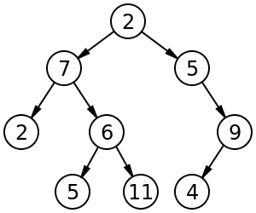
Definition
A data structure in which a record is linked to two successor records, usually referred to as the left branch when greater and the right when less than the previous record.

Slide 26
Tree Terminology
A binary tree is made of nodes, where each node contains a "left" reference, a "right" reference, and a data element. The topmost node in the tree is called the root
Every node (excluding a root) in a tree is connected by a directed edge from exactly one other node which is called a parent
On the other hand, each node can be connected to arbitrary number of nodes, called children
Nodes with no children are called leaves or external nodes
Nodes which are not leaves are called internal nodes
Nodes with the same parent are called sibling

Slide 27
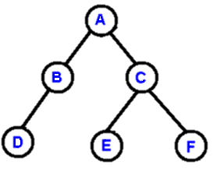
More Tree Terminology
The depth of a node is the number of edges from the root to the node.
The height of a node is the number of edges from the node to the deepest leaf.
The height of a tree is a height of the root.

Slide 28
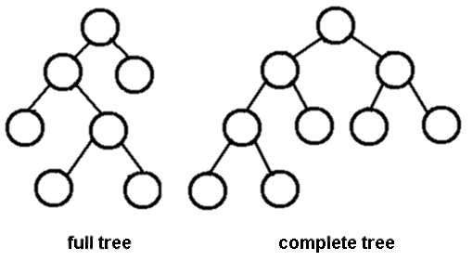
Full & Complete Binary Tree
A full binary tree is a binary tree in which each node has exactly zero or two children.
A complete binary tree is a binary tree, which is completely filled, with the possible exception of the bottom level, which is filled from left to right.

Slide 29
Advantages of Trees
Trees are so useful and frequently used, because they have some very serious advantages:-
Trees reflect structural relationships in the data
Trees are used to represent hierarchies
Trees provide an efficient insertion and searching
Trees are very flexible data, allowing to move subtrees around with minimum effort

Slide 30
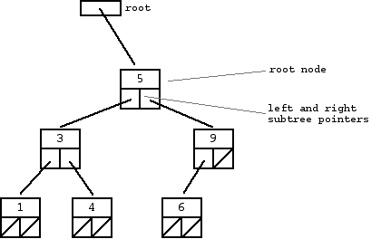
Declaring a Binary Tree in C
struct node {
int value;
struct node * left;
struct node * right;
}

Slide 31
Traversals
A traversal is a process that visits all the nodes in the tree. Since a tree is a nonlinear data structure, there is no unique traversal. We will consider several traversal algorithms with we group in the following two kinds:-
depth-first traversal
breadth-first traversal
There are three different types of depth-first traversals:-
PreOrder traversal - visit the parent first and then left and right children;
InOrder traversal - visit the left child, then the parent and the right child;
PostOrder traversal - visit left child, then the right child and then the parent;

Slide 32
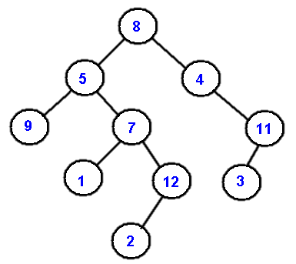
Example: Traversals
As an example consider the following tree and its four traversals:
PreOrder - 8, 5, 9, 7, 1, 12, 2, 4, 11, 3
InOrder - 9, 5, 1, 7, 2, 12, 8, 4, 3, 11
PostOrder - 9, 1, 2, 12, 7, 5, 3, 11, 4, 8
LevelOrder - 8, 5, 4, 9, 7, 11, 1, 12, 3, 2

Slide 33
Linked List

Slide 34
Definition
A linked list is a sequence of data structures, which are connected together via links.
Linked list is a sequence of links which contains items.
Each link contains a connection to another link.
Important terms to understand the concept of linked list.
Data − Each link of a linked list can store a data called an element
Next − Each link of a linked list contains a link to the next link called Next
List − A list contains the connection link to the first link called Head

Slide 35
Linked List Representation
Linked list can be visualized as a chain of nodes, where every node points to the next node
Important points to be considered:
Linked list contains a link element called Head
Each link carries a data field(s) and a link field called next
Each link is linked with its next link using its next link
Last link carries a link as null to mark the end of the list

Slide 36
Defining A Linked List
struct node {
int data;
struct node *next;
};

Slide 37
Why Linked List?
Arrays can be used to store linear data of similar types, but arrays have following limitations.
The size of the arrays is fixed
Inserting a new element in an array of elements is expensive
Advantages over arrays
Dynamic size
Ease of insertion/deletion
Drawbacks of linked list
Random access is not allowed. We cannot do binary search with linked lists.
Extra memory space for a pointer is required with each element of the list.

Slide 38
Other Examples

Slide 39
Example: Comparing Dates
#include <stdio.h>
struct date {
int dd, mm, yy;
} ;
int date_cmp(struct date d1, struct date d2);
void date_print(struct date d);
int main(){
struct date d1 = {7, 3, 2015};
struct date d2 = {24, 10, 2015};
int cmp = date_cmp(d1, d2);
date_print(d1);
if (cmp == 0)
printf(" is equal to");
else if (cmp > 0)
printf(" is greater, i.e., later than ");
else printf(" is smaller, i.e., earlier than");
date_print(d2);
return 0;
}

Slide 40
Comparing Dates
/* compare given dates d1 and d2 */
int date_cmp(struct date d1, struct date d2) {
if (d1.dd == d2.dd && d1.mm == d2.mm && d1.yy == d2.yy)
return 0;
else if (d1.yy > d2.yy || d1.yy == d2.yy && d1.mm > d2.mm || d1.yy == d2.yy && d1.mm == d2.mm && d1.dd > d2.dd)
return 1;
else return -1;
}
/* print a given date */
void date_print(struct date d) {
printf("%d/%d/%d", d.dd, d.mm, d.yy);
}
OUTPUT
7/3/2015 is smaller, i.e., earlier than 24/10/2015

Slide 41
Example: Add Two Complex Numbers
#include <stdio.h>
typedef struct complex
{
float real;
float imag;
} complex;
int main()
{
complex n1, n2, temp;
printf("For 1st complex number \n");
printf(" Enter re & im part respectively:\n");
scanf("%f %f", &n1.real, &n1.imag);
printf("\nFor 2nd complex number \n");
printf("Enter re & im part respectively:\n");
scanf("%f %f", &n2.real, &n2.imag);
temp = add(n1, n2);
printf("Sum = %.1f + %.1fi", temp.real, temp.imag);
return 0;
}

Slide 42
Add Two Complex Numbers
complex add(complex n1, complex n2)
{
complex temp;
temp.real = n1.real + n2.real;
temp.imag = n1.imag + n2.imag;
return(temp);
}
OUTPUT
For 1st complex number
Enter re & im part respectively: 2.3
4.5
For 2nd complex number
Enter re & im part respectively: 3.4
5
Sum = 5.7 + 9.5i

Slide 43
Any question?
You may post your question(s) at the “Discussion Forum” maintained in the course Web page.

Slide 44
Problems to ponder…
Will be posted shortly…

Slide 45
Problems for practice…
Will be posted shortly…

